Slide 1
Web Analytics
ADVANCED SOCIAL,
TEXT AND MEDIA ANALYTICS
UNIT – II Chapter - II
DEPARTMENT OF CSBS

Slide 2
UNIT – II
Web Analytics: Web analytics tools, Clickstream analysis, A/B testing, online surveys; Web search and retrieval, Search engine optimization, Web crawling and Indexing, Ranking algorithms, Web traffic models.

Slide 3
Web Searching
The most productive way to conduct a search on the internet is through a search engine. A web search engine is a software system designed to search for information on the World Wide Web. The search results are generally presented in a line of results often referred to as search engine results pages (SEROs). The information may be a mix of web pages, images, and other types of files. Some search engines also mine data available in databases or open directories.

Slide 4
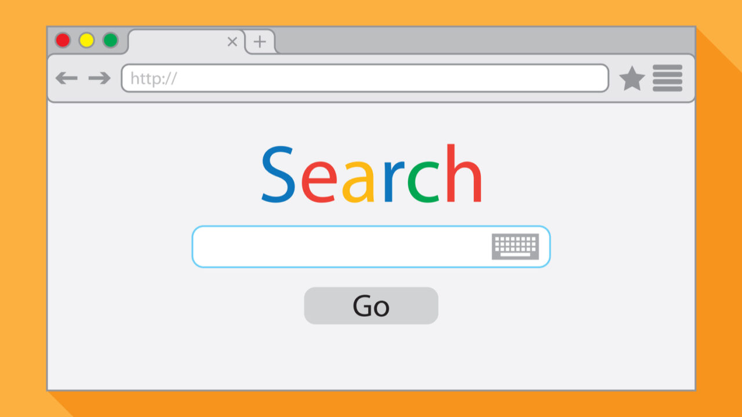

Slide 5
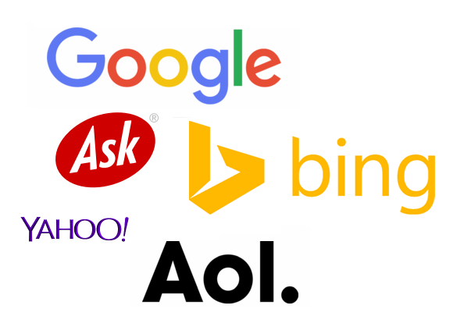
Cont ..
Various search engines are available to search the web. The top web search engines are Google, Bing, Yahoo, Ask.com, and AOL.com.

Slide 6
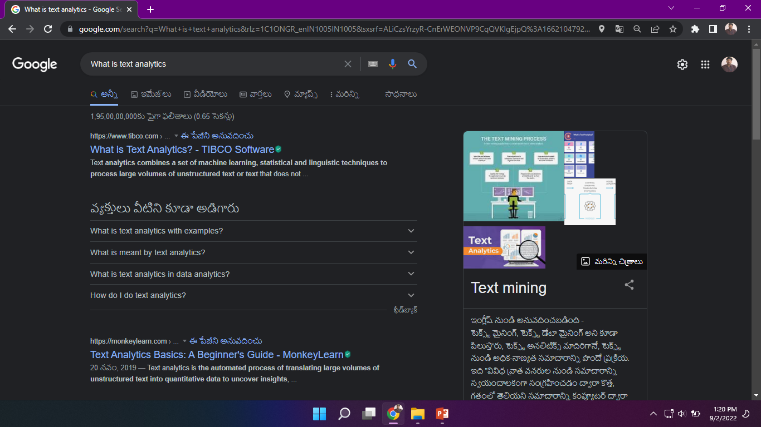

Slide 7
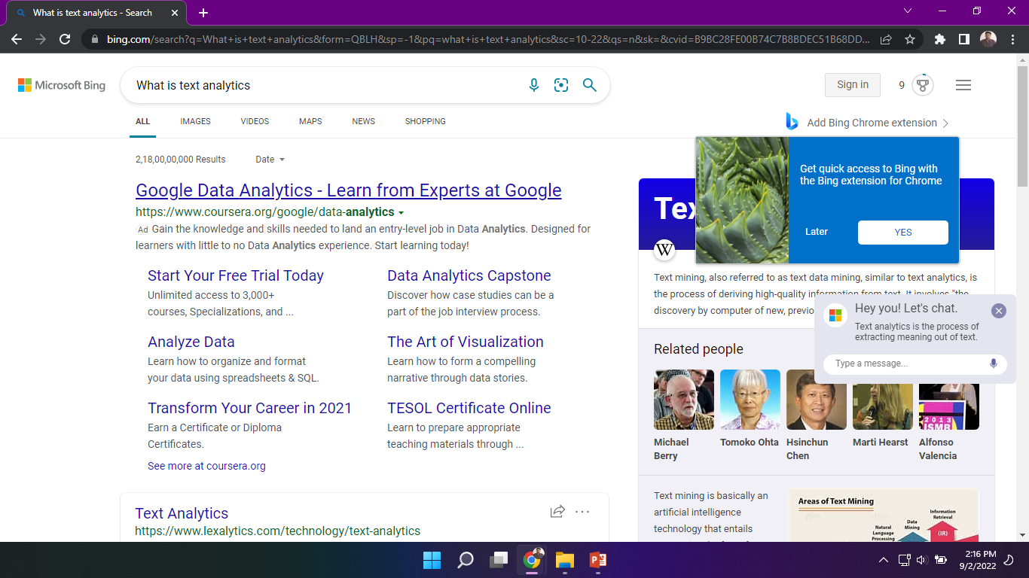

Slide 8
Web Information Retrieval
Web Information retrieval is the process of searching within World Wide Web document collection for a particular information need (called a query).
The utility and universality of web search is making Web Information Retrieval.
Web Information retrieval can be defined as the application of theories and methodologies from IR to the World Wide Web.

Slide 9
CHARACTERISTICS OF WEB IR
Huge size
Dynamic
Self-Organized
Heterogeneity
Duplication
Hyperlinked

Slide 10
worldwidewebsize.com

Slide 11
Huge size
The Web is indeed huge! In fact, it's so big that it's hard to get an accurate count of its size. By July 13, 2013, according to worldwidewebsize.com it was estimated that the Web contained at least 4.12 billion pages. with an average page size of 500KB.
Dynamic
The web is dynamic. Anyone can publish any type of material on to the web at any time. Thus information onto the web is constantly changing and being updated. This clearly contrast with traditional static document collections for the two reasons. First, once a document is added to a traditional collection, it does not change. Second, for the most part, the size of a traditional document collection is relatively static.

Slide 12
Self-Organized
On the Web, anyone can post a webpage and link away at will. There are no standards and no gatekeepers policing content, structure, and format. The data are volatile; there are rapid updates, broken links, and file disappearances. In contrast traditional document collections are usually collected and categorized by trained (and often highly paid) specialists.
Heterogeneity
The data is heterogeneous, existing in multiple formats, languages, and alphabets with duplicity of this data at various places. In addition, there is no editorial review process, which means errors, falsehoods, and invalid statements abound.

Slide 13
Duplication
Several studies indicate that nearly 30% of the web's content is duplicated, mainly due to mirroring.
Hyperlinked
The web is hyperlinked. Hyperlinks make focused, effective searching a reality.

Slide 14
WEB IR COMPONENTS
The four main components of Web Search are Crawling, Indexing, Querying and Ranking.
During the web search the first two are performed offline and last two are done online.
Crawling and Indexing is query independent and Querying and Ranking is query dependent.

Slide 15
Crawling
Crawling is a process that allows search engines to discover new content on the internet. To do this, they use crawling bots or Spiders that follow links (URL) from the already known webpages to the new ones.
The web crawler is a computer program or automated script that crawls through the World Wide Web in a predefined and methodical manner to collect data.
The web crawler tool pulls together details about each page: titles, images, keywords, other linked pages, etc. It automatically maps the web to search documents, websites, and email addresses. It then stores and indexes this data.

Slide 16
Cont ..
Web crawler also known as the spider or spider bot, the spider crawl program moves from one website to another, capturing every website. All contents are read and entries are created for a search engine index.
Every search engine uses its own web crawler to collect data from the internet and index search results. For instance, Google Search uses the Googlebot.

Slide 17
Cont ..
Web crawlers visit new websites and sitemaps that have been submitted by their owners and periodically revisit the sites to check for updates. So, if you search for the term “web crawler” on Google, the results you get today may differ from what you got a few weeks ago.
This is because a web crawler is continually at work, searching for relevant websites that define or describe a “web crawler” in the best manner, factoring in new websites, web pages, or updated content.

Slide 18
Web Indexing
Web index is a tool used for searching web documents like, individual websites or collections of web sites or collections of webpages and so on.
It is a browsable list of terms or sections leading towards further reading /resources to the desired topic or subject. Sitemap is an example of a web index.
Search engine indexing collects, parses, and stores data to facilitate fast and accurate information retrieval. An alternate name for the process in the context of search engines designed to find web pages on the Internet is web indexing.

Slide 19
Cont ..
Search engines index websites in order to respond to search queries with relevant information as quickly as possible. For this reason, it stores information about indexed web pages, e.g. keyword, title or descriptions, in a database. This way search engines can quickly identify pages relevant to a search query.
Indexing has the additional purpose of giving a page a certain weight, as described in the search algorithms. This way search results can be ranked, after being indexed.

Slide 20
Cont ..
The index is organized according to the exact keyword the user searches and the pages that are most likely to match the user’s query.
A page’s ranking is not universal; in fact, the specific rank a page has on a google Search Engine Results Page (SERP) will likely be different from that on Bing or Yahoo and vice versa.

Slide 22
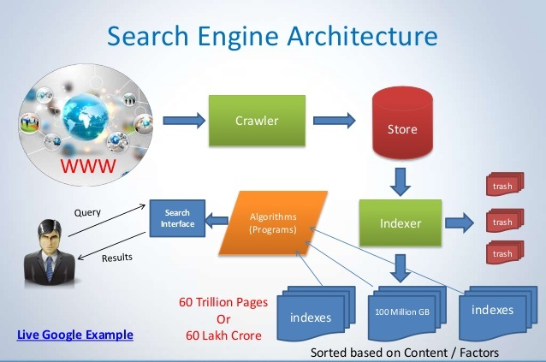

Slide 23
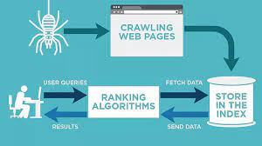

Slide 24
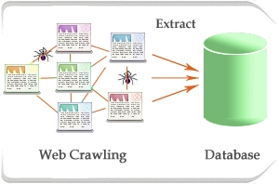

Slide 25
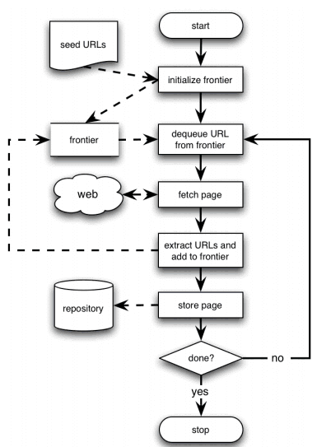

Slide 26
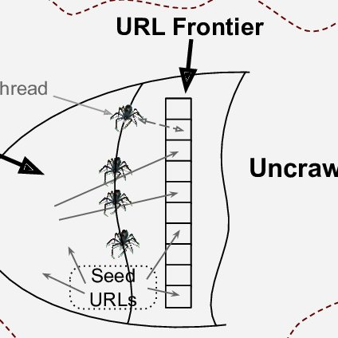

Slide 29
How Search Engine Works?
Search engines perform several activities in order to deliver search results.
Crawling - Process of fetching all the web pages linked to a website. This task is performed by a software, called a crawler or a spider (or Googlebot, in case of Google).
Indexing - Process of creating index for all the fetched web pages and keeping them into a massive database from where it can future be retrieved. Essentially, the process of indexing is identifying the words and expressions that best describe the page and assigning the page to particular keywords.
https://vwo.com/ab-testing/

Slide 30
Cont ..
Processing - When a search request comes, the search engine processes it, i.e. it compares the search string in the search request with the indexed pages in the database.
Calculating Relevancy - It is likely that more than one page contains the search string, so the search engine starts calculating the relevancy of each of the pages in its index to the search string.
Retrieving Results - The last step in search engine activities is retrieving the best matched results. Basically, it is nothing more than simply displaying them in the browser.

Slide 31
Key Metrics used by Search Engines
Links: The links from other sites are called backlinks. These links help in determining the ranking of a site in search engine results pages (SERPs). A link is considered as a vote of quality from other websites, as a website owner would not link to a site that is of poor quality.
Content: The quality of content is also a vital parameter in determining the ranking of a site. The content should be unique, relevant for the given search query.
Page Structure: The web pages are written in HTML; the html coding of a page is also used by search engines to evaluate a page. So include important keywords in the title, URL, and other meta tags and also make sure the site is crawlable.

Slide 32
Web Ranking
Rank refers to the position of a website or page in a list of search engine results for a specific keyword. A higher ranking is the goal of a search engine optimization (SEO) strategy. The higher a page ranks for a particular keyword, the more likely users are to visit the site.
Page ranking starts with a process called crawling. This occurs when a search engine sends a team of robots (called “spiders” or “web crawlers“) to collect information about the new and updated URLs and the content they contain across the internet. This information is then stored in the search engine’s index, which users access when performing queries.

Slide 33
Cont ..
PageRank (PR) is an algorithm used by Google Search to rank websites in their search engine results. PageRank was named after Larry Page, one of the founders of Google. PageRank is a way of measuring the importance of website pages.
PageRank works by counting the number and quality of links to a page to determine a rough estimate of how important the website is. The underlying assumption is that more important websites are likely to receive more links from other websites.

Slide 34
What is SEO
SEO stands for Search Engine Optimization. It is a process designed to optimize a website for search engines. It helps websites achieve a higher ranking in search engine results when people search for keywords related to their products and services. So, it is a practice of increasing the quantity and quality of traffic to a website through organic search engine results.

Slide 35
Cont ..
SEO is all about optimizing a website for search engines. SEO is a technique for:
Designing and developing a website to rank well in search engine results.
Improving the volume and quality of traffic to a website from search engines.
Marketing by understanding how search algorithms work, and what human visitors might search.
SEO is a subset of search engine marketing. SEO is also referred as SEO copyrighting, because most of the techniques that are used to promote sites in search engines, deal with text.

Slide 36
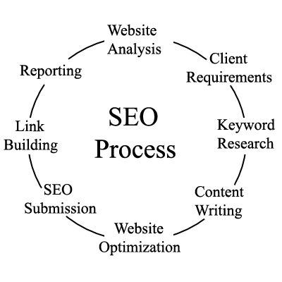
Cont ..

Slide 37
How do I optimize my website for Google?
Understand what keywords people are searching for
Create content that searchers want to see
Get clicks with a exciting title
Keep URLs short and descriptive
Optimize your images
Make sure your content is easy to read
Get high-quality, relevant backlinks

Slide 38
Understand what keywords people are searching for
People search for your brand or business in tons of different ways.
For example, let’s say that you’re a hairdresser in San Francisco. People could search for “hairdresser in San Francisco,” “San Francisco hairdresser” or possibly even “hairdresser near me.”
Although they’re all phrased differently, they’re essentially asking the same thing.
So it’s really important to start by finding the most popular ways that people are searching for you. This way, you can cater to and optimize your content for those phrases (i.e., keywords.)
You have two options: guesswork, or keyword research tools.
Google Trends is one good (and free-of-charge) option that shows you the relative popularity of any search queries you enter.

Slide 39
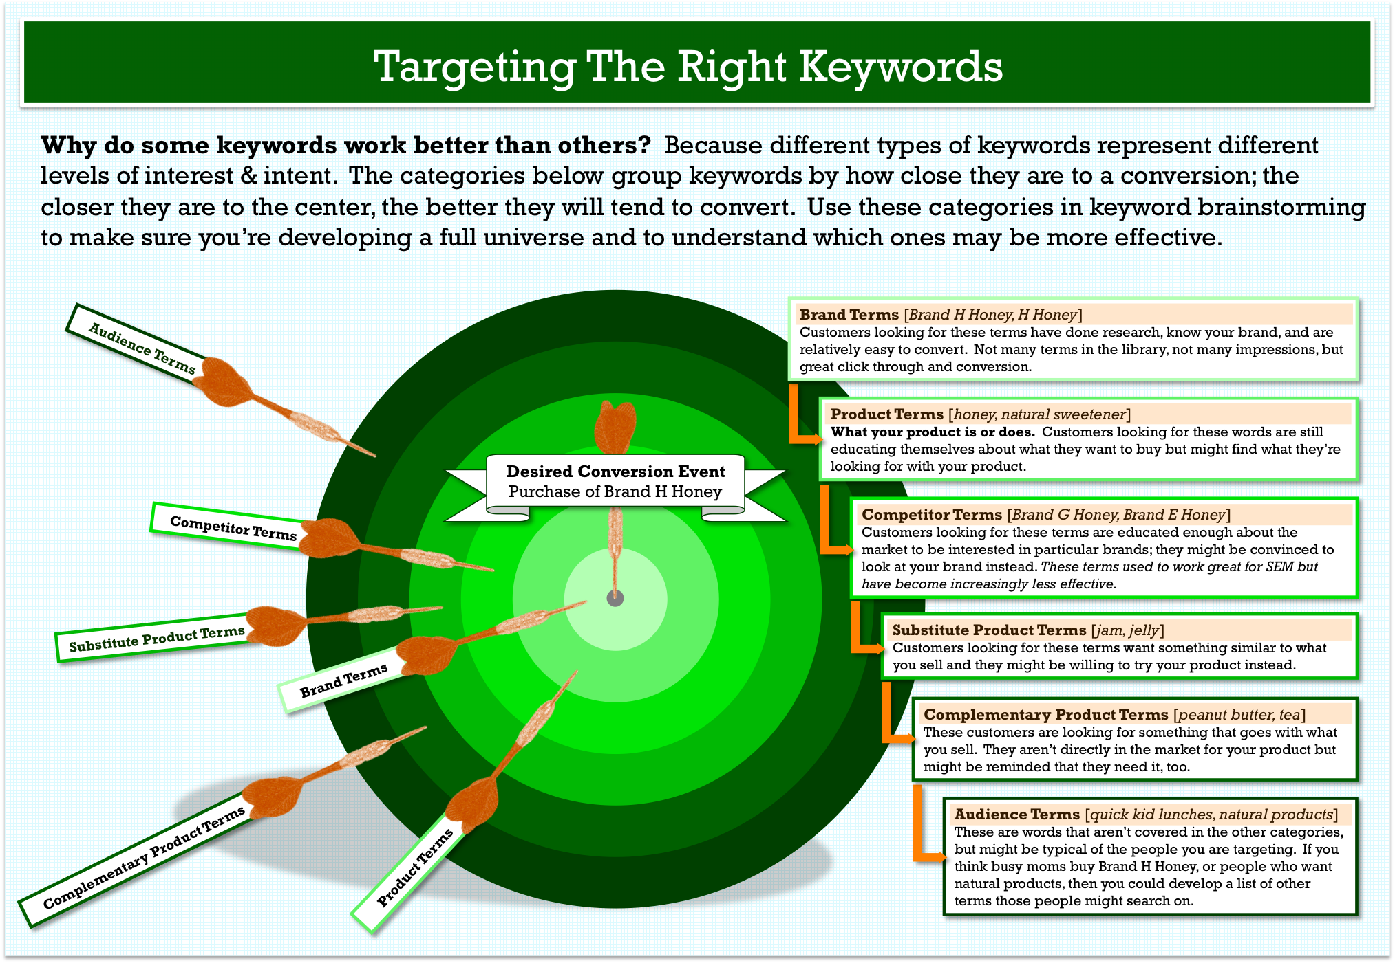

Slide 40
Create content that searchers want to see
Google’s algorithm already works to serve the most relevant content for each search query, we can use this to our advantage. Just look at the existing top results to figure out what people are looking for.
Think about our topic of hairdressing.
I can’t figure out what people want to know just by looking at this term on my own. Do they want to know more about hairdressing techniques? Do they want to find a good hair salon?
We can check this in Google by typing in the term (note that the results are automatically localized to your country), or in Ahrefs’ Keywords Explorer simply scroll down to “SERP overview” to see the top results for your keyword.

Slide 41
Get clicks with a exciting title
With that said, here’s a good set of rules that will get you off on the right foot:
Stay true to search intent. Don’t forget the previous step and stray too far!
Avoid truncation. Google cuts your title off with the dreaded ellipses (…) if it gets too long, which hurts your click-through rates. Use this tool to check that it falls within limits.
Make it descriptive (but not clickbait). See the example above: phrases like “deceptively easy” make the title more enticing than just “simple.”
Include your unique selling point. Sell your brand, whether it’s “free delivery”, “est. 1975”, “only uses fresh milk from Hokkaido”…you get the gist.
Include your keywords if possible. Prioritize keeping your title natural-sounding and avoid keyword stuffing. Be honest; how do you feel about this description? “We’re a hair salon in California with the best hairdressers in California. Looking for a California natural hair salon? We are one of the leading organic hair salons in California.” It sounds unnatural, right?

Slide 42
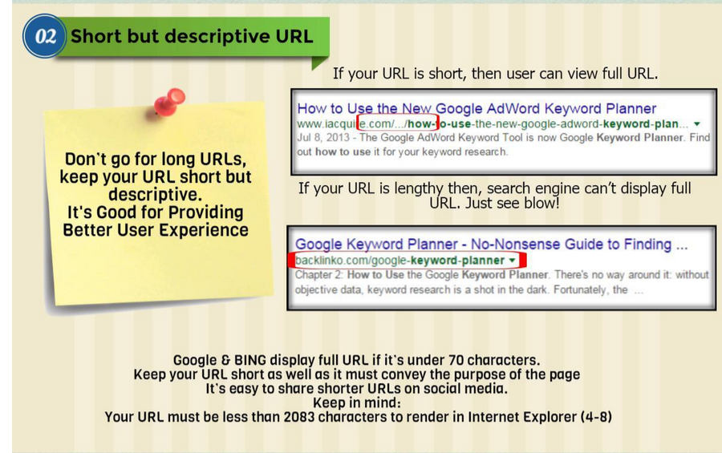
Keep URLs short and descriptive
Your URL could be https://www.coffeegrinders.com/2018/01/15/287539884.php
Or it could be
https://www.coffeegrinders.com/bialetti-macinacaffe-review/
Which one includes the keywords you’re looking to target with this article? Which one are you more likely to click on in the search results?
Keep your URLs as short and sweet as possible.

Slide 43
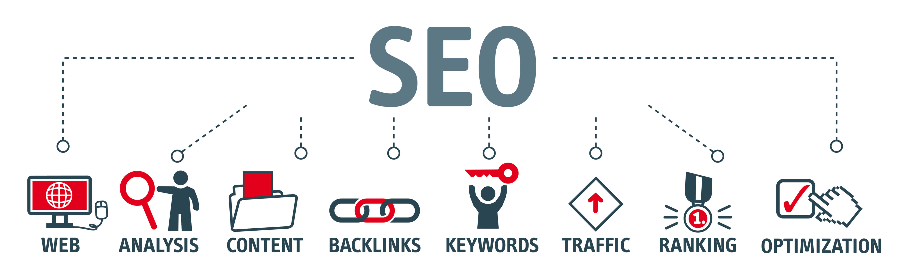
Optimize your images

Slide 44
Make sure your content is easy to read
If your content is difficult to read and digest, readers are going to leave (and for good reason).
Start using <h1>, <h2> and <h3> tags in your webpages. Think of these as a hierarchy for your content, with <h1> being the most important (and only used once per post), and <h2> being a subheading. <h3> is a subheading of <h2> and so on.
Here’s an example of a heading structure:
H1: Ponytails are great
H2: Why are ponytails so great?
H3: They are easy to do
H3: There are lots of ways to style them
H2: How to tie a ponytail
H3: High ponytail
H3: Low ponytail

Slide 45
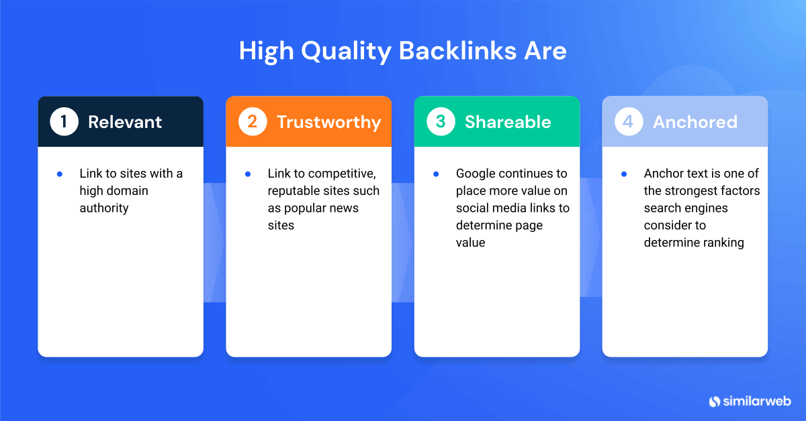

Slide 46
Get high-quality, relevant backlinks
Backlinks are very, very important.
Let’s start by breaking it down a little.
Firstly, what’s a backlink?
It’s an incoming hyperlink from another website, or referring domain, to your target webpage.
In plain English, when another website links to you, it’s giving you a backlink.

Slide 47
Web Trafficking Models
https://www.cyberclick.net/numericalblogen/types-of-web-traffic-sources-and-explanations

